Slide 1
The Battle of Neighborhoods
Opening a Shopping Mall in Hyderabad , Telangana, INDIA
Capstone Project of IBM Data Science
-by Pranay Thatikonda, July 2020

Slide 2
Business Problem
Location of the Shopping malls is one of the most important decisions that will determine whether the mall will run in profits or not
Objective: To analyze and select best locations in the city of Hyderabad to open a new shopping mall
This project is timely as the city is suffering from undersupply of shopping malls
Business question: “ In the city of Hyderabad , Telangana state of India, if someone is looking to open a Shopping Mall, where would you recommend that they open it? ”

Slide 3
Data
Required data:
List of Neighborhoods in Hyderabad
Latitude and Longitude coordinates of those neighborhoods
Venue data, Shopping mall category in particular
Sources of above data:
Wikipedia url: "https://en.wikipedia.org/wiki/List_of_neighbourhoods_in_Hyderabad"
Geocoder library to get coordinates
Foursquare API for venue data

Slide 4
Methodology
Web scraping wiki page to get neighborhoods list
Get coordinates using geocoder library
Use FourSquare API to get venue data
Group by Neighborhood and taking the mean of the frequency occurrence of the each venue category
Filter venue category by “Shopping Mall”
Form clusters using K-means
Create Map using cluster and Neighborhood data

Slide 5
Results
Cluster 0 (Red colour) : With only 1 Neighborhood with mean value more than all the clusters as it is an industrial area with small shopping malls around it
Cluster 1 (Purple colour) : With almost no shopping malls present in these neighborhoods, some of the areas might be having one or two shopping malls but our model did not detect it because of the radius(2000m) that we have chosen.
Cluster 2,3,4 (Blue, Green, Orange) : These clusters 2,3 and 4 has enough number of shopping malls in these neighborhoods with different frequencies of mean. Neighborhoods in clusters 2 and 3 comes under main city or popular areas of the city Hyderabad.

Slide 6
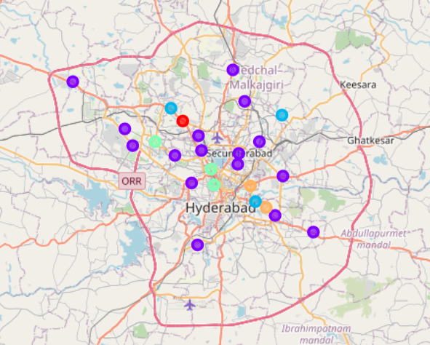
Clusters formed using K-means

Slide 7
Conclusion
Answer to business question: The neighborhoods in cluster 1 are the most preferred locations to open a new shopping mall
Visualization and the Foursquare API for community data processing, it is possible to cluster city shopping mall data on the basis machine learning techniques – K-Means Algorithm.
This study can be reproduced easily for any other cities across the world

